Slide 1

Learning Objectives
LO1 Analyze a payroll transaction.
LO2 Journalize a payroll including employee payroll taxes.
© 2014 Cengage Learning. All Rights Reserved.

Slide 2
Different Forms of Payroll Information
Lesson 13-1
LO1
The total of gross earnings for all employees earning hourly wages, salaries, and commissions is called salary expense.

Slide 3
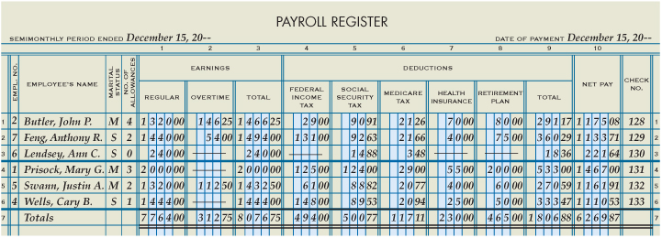
Analyzing Payment of Payroll
Lesson 13-1
LO1

Slide 4
Analyzing Payment of Payroll
Lesson 13-1
LO1
Employee Income Tax Payable
Dec. 15 494.00
Social Security Tax Payable
Dec. 15 500.77
Medicare Tax Payable
Salary Expense
Dec. 15 117.11
=
Health Insurance Premiums Payable
Dec. 15 8,076.75
Dec. 15 230.00
Retirement Contributions Payable
Dec. 15 465.00
Cash
Dec. 15 6,269.87
Dec. 15 6,269.87

Slide 5
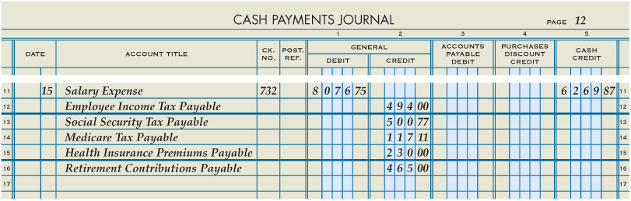
Journalizing Payment of a Payroll
Lesson 13-1
LO2
December 15. Paid cash for semimonthly payroll, $6,269.87 (total payroll, $8,076.75, less deductions: employee income tax, $494.00; social security tax, $500.77; Medicare tax, $117.11; health insurance premiums, $230.00; retirement contributions, $465.00). Check No. 732.
1
Date
2
Account Debited
3
Check Number
4
Total Earnings
Accounts Credited
Payroll Deductions
Amount Paid to Employees
6
7
5

Slide 6

Lesson 13-1 Audit Your Understanding
Lesson 13-1
1. What account title is used to journalize the Total Earnings column of the payroll register?
ANSWER
Salary Expense

Slide 7
Lesson 13-1 Audit Your Understanding
Lesson 13-1
2. What account title is used to journalize the Federal Income Tax column of the payroll register?
ANSWER
Employee Income Tax Payable

Slide 8
Lesson 13-1 Audit Your Understanding
Lesson 13-1
3. What account title is used to journalize the Social Security Tax column of the payroll register?
ANSWER
Social Security Tax Payable

Slide 9
Lesson 13-1 Audit Your Understanding
Lesson 13-1
4. What account title is used to journalize the Medicare Tax column of the payroll register?
ANSWER
Medicare Tax Payable

Slide 10
Work Together 13-1 On You Own 13-1
Work Together
13-1 (Excel)
Modeled
Page 381
On Your Own
13-1 (Excel)
Complete
Page 381

Slide 11

Learning Objectives
LO3 Calculate and record employer payroll taxes.
© 2014 Cengage Learning. All Rights Reserved.

Slide 12
Employer Payroll Taxes
Lesson 13-2
LO3
Employer Social Security and Medicare taxes
Federal unemployment tax
A federal tax paid by employers to administer the unemployment program is called federal unemployment tax, commonly referred to as FUTA.
State unemployment tax
A state tax paid by employers that is used to pay benefits to unemployed workers is called state unemployment tax, commonly referred to as SUTA.

Slide 13
FUTA and SUTA
Taxable Income
First $7,000 earned by the employee
FUTA
0.8%
SUTA
5.4%

Slide 14
Calculating Unemployment Taxes
Lesson 13-2
LO3
THREEΔGREEN PRODUCTS, INC. Calculation of FUTA Earnings for December 15, 20-- Pay Period
1 | 2 | 3 | 4 | 5
Employee | Prior Accumulated Earnings | Earnings to Equal FUTA Tax Base | Earnings for Current Pay Period | FUTA Earnings
Butler, John P. | $27,195.00 | $ 0.00 | $1,466.25 | $ 0.00
Feng, Anthony R. | 5,260.00 | 1,740.00 | 1,494.00 | 1,494.00
Lendsey, Ann C. | 1,648.00 | 5,352.00 | 240.00 | 240.00
Prisock, Mary G. | 44,000.00 | 0.00 | 2,000.00 | 0.00
Swann, Justin A. | 16,089.00 | 0.00 | 1,432.50 | 0.00
Wells, Cary B. | 6,490.00 | 510.00 | 1,444.00 | 510.00
 |  |  |  | $2,244.00
Enter prior accumulated earnings
1
Enter the difference between the FUTA tax base and prior accumulated earnings
Enter earnings for the current pay period
Enter the FUTA earnings
2
3
4

Slide 15
Journalizing Employer Payroll Taxes
Lesson 13-2
LO3
December 15. Recorded employer payroll taxes expense, $757.01, for the semimonthly pay period ended December 15. Taxes owed are: social security tax, $500.77; Medicare tax, $117.11; federal unemployment tax, $17.95; state unemployment tax, $121.18. Memorandum No. 44.
Payroll Taxes Expense
Dec. 15 757.01
Social Security Tax Payable
Dec. 15 500.77
500.77
Medicare Tax Payable
Dec. 15 117.11
117.11
Unemployment Tax Payable—Federal
Dec. 15 17.95
Unemployment Tax Payable—State
Dec. 15 121.18

Slide 16
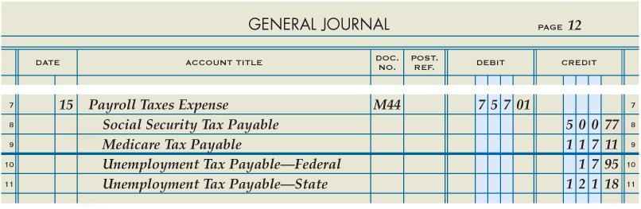
Journalizing Employer Payroll Taxes
Lesson 13-2
LO3
1
Date
2
Account Debited
3
Memorandum Number
5
Accounts Credited
4
Amount Debited
6
Amounts Credited

Slide 17
Lesson 13-2 Audit Your Understanding
Lesson 13-2
1. What is the tax rate ThreeGreen must pay on employees for each of the following taxes: social security, Medicare, federal unemployment, and state unemployment?
ANSWER
Social security: 6.2% of employee earnings up to a maximum of $118,500.00 in each calendar year (2015 Tax Year)
Medicare: 1.45% of total employee earnings
FUTA: 0.8% on the first $7,000.00 earned by each employee
SUTA: 5.4% on the first $7,000.00 earned by each employee

Slide 18
Lesson 13-2 Audit Your Understanding
Lesson 13-2
2. What is the amount of each employee’s earnings that is subject to federal and state unemployment taxes at ThreeGreen?
ANSWER
The first $7,000.00

Slide 19
Work Together 13-2 On You Own 13-2
Work Together
13-2 (Excel)
Modeled
Page 386
On Your Own
13-2 (Excel)
Complete
Page 386

Slide 20

Learning Objectives
LO4 Prepare selected payroll tax reports.
© 2014 Cengage Learning. All Rights Reserved.

Slide 21
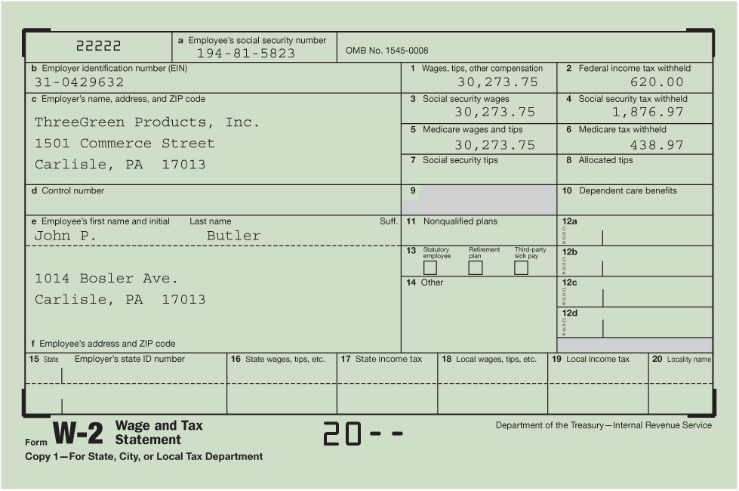
Employer Annual Report to Employees of Taxes Withheld
Lesson 13-3
LO4

Slide 22
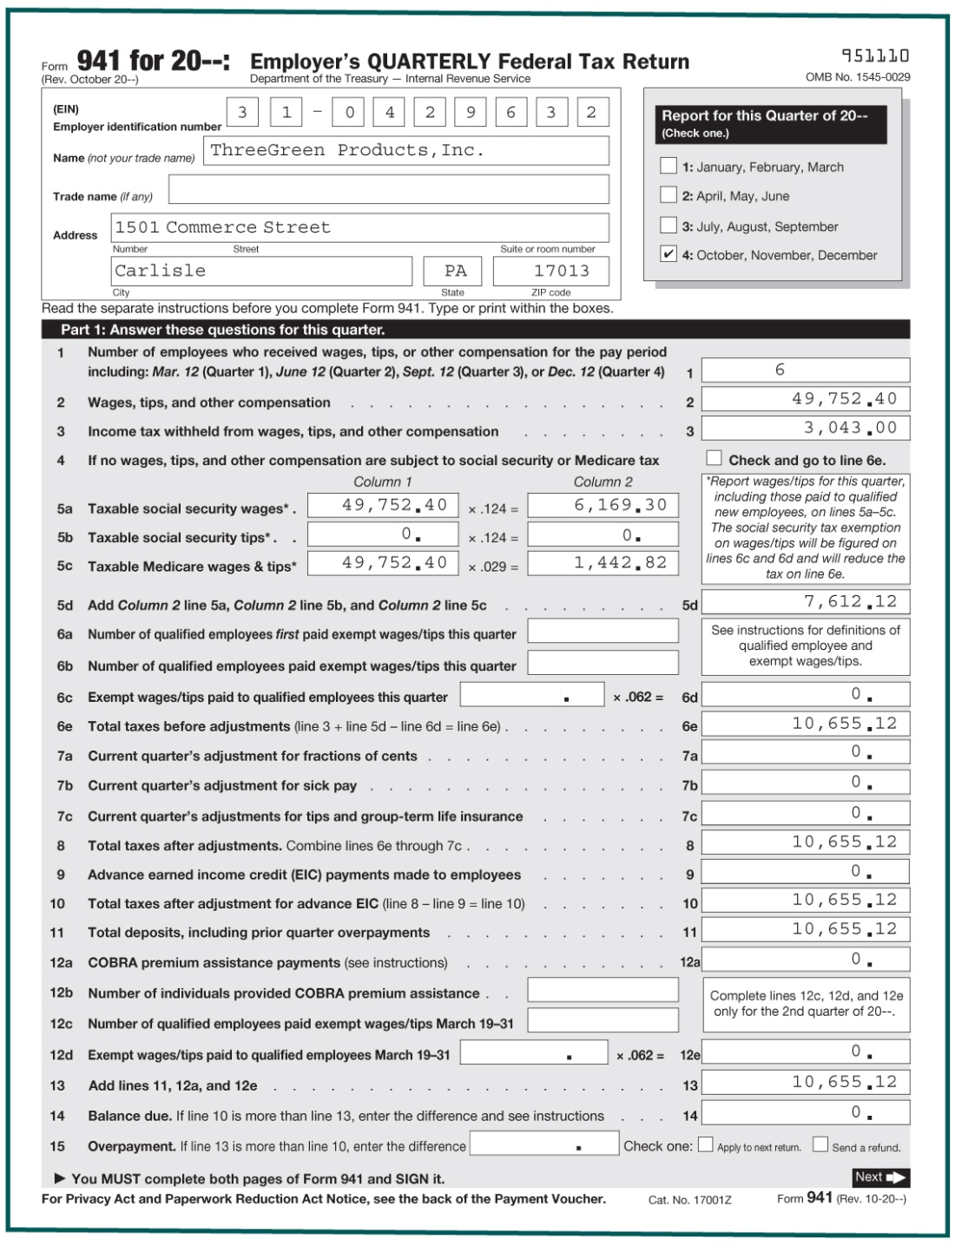
Employer’s Quarterly Federal Tax Return
Lesson 13-3
LO4
1
Heading
2
Number of Employees
3
Total Quarterly Earnings
4
Income Tax Withheld
5
Employee and Employer Social Security and Medicare Taxes
6
Total Employee and Employer Social Security and Medicare Taxes
7
Total Taxes

Slide 23
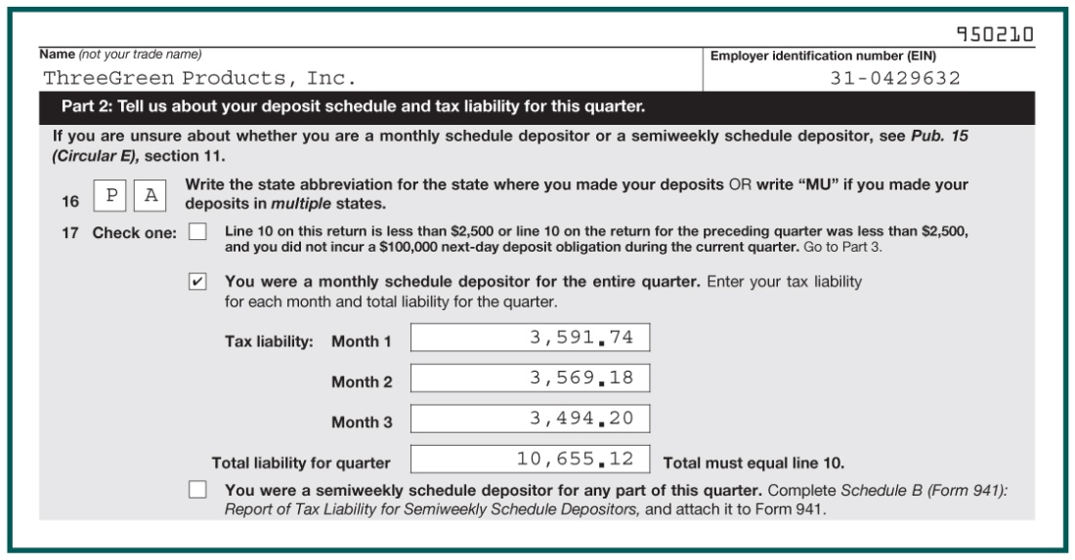
Employer’s Quarterly Federal Tax Return
Lesson 13-3
LO4
State Abbreviation
8
Monthly Schedule Depositor
9
Monthly Deposits
10
Total Deposits
11

Slide 24
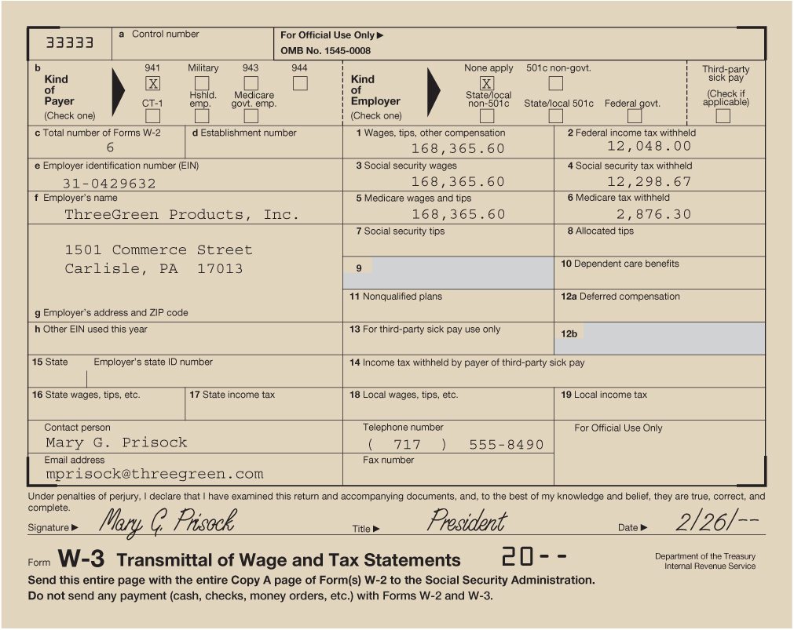
Employer Annual Reporting of Payroll Taxes
Lesson 13-3
LO4

Slide 25
Lesson 13-3 Audit Your Understanding
Lesson 13-3
1. When must employers furnish a W-2 statement to their employees?
ANSWER
By January 31 of the following year

Slide 26
Lesson 13-3 Audit Your Understanding
Lesson 13-3
2. What taxes are included in the quarterly federal tax return filed by the employer?
ANSWER
Federal income tax
Social security tax
Medicare tax

Slide 27
Work Together 13-3 On You Own 13-3
Work Together
13-3 (Worksheet)
Print Form 941
Modeled
Page 391
On Your Own
13-3 (Worksheet)
Print Form 941
Complete
Page 391

Slide 28

Learning Objectives
LO5 Pay and record withholding and payroll taxes.
© 2014 Cengage Learning. All Rights Reserved.

Slide 29
Paying the Liability for Employee Income Tax, Social Security Tax, and Medicare Tax
Lesson 13-4
LO5
Employers must pay to the federal, state, and local governments all payroll taxes withheld from employee earnings as well as the employer payroll taxes.
The payment of payroll taxes to the government is referred to as a deposit.
The 12-month period that ends on June 30 of the prior year that is used to determine how frequently a business must deposit payroll taxes is called the lookback period.

Slide 30
Lookback Period
Jan 8th 2016
June 30th 2014
June 30th 2015
April 24th 2016
July 4th 2016
Current Date Examples
Lookback Period
12th Month Period that Ends June 30th of the Prior Year
Used to Determine How Frequently a Business Must Deposit Payroll Taxes

Slide 31
Paying the Liability for Employee Income Tax, Social Security Tax, and Medicare Tax
Lesson 13-4
LO5
Are the total taxes for the prior quarter less than $2,500 and all of the current quarter tax liabilities within a deposit period less than S100,000? If unsure, answer NO.
Deposit taxes by the end of the month after the end of the quarter, or mail taxes with Form 941.
YES
NO
Have you accumulated a tax liability of $100,000 or more within a deposit period?
YES
Deposit taxes by the next banking day.
NO
Did you fall under the $100,000 rule at any time during this year or last year?
YES
You are a Semiweekly Schedule Depositor.
Deposit taxes from paydays paid on:
Wednesday, Thursday and Friday by the following Wednesday.
Saturday, Sunday, Monday and Tuesday by the following Friday.
NO
Are the total taxes for the Lookback Period more than $50,000?
YES
NO
You are a Monthly Schedule Depositor. Deposit taxes for the month by the 15th of the following month.

Slide 32
Making Federal Tax Deposits
Lesson 13-4
LO5
New employers are monthly schedule depositors for the first calendar year of business.
After a lookback period is established, the business must evaluate whether a change in its deposit period is required.
Federal tax deposits must be paid using electronic fund transfers.
Deposits can also be made using the Electronic Federal Tax Payment System (EFTPS).
Tax rules change periodically.

Slide 33
Journalizing Payment of Liability for Employee Income Tax, Social Security Tax, and Medicare Tax
Lesson 13-4
LO5
January 15. Paid cash for liability for employee income tax, $998.00; social security tax, $2,023.06; and Medicare tax, $473.14; total, $3,494.20. Check No. 748.
Employee Income Tax Payable
Dec. 15 494.00
Dec. 31 504.00
Jan. 15 Bal 998.00
Jan. 15 Bal 998.00
Social Security Tax Payable
Dec. 15 500.76
Dec. 15 500.76
Dec. 31 510.77
Dec. 31 510.77
Jan. 15 Bal 2,023.06
Jan. 15 Bal 2,023.06
Medicare Tax Payable
Dec. 15 117.11
Dec. 15 117.11
Dec. 31 119.46
Dec. 31 119.46
Jan. 15 Bal 473.14
Jan. 15 Bal 473.14
Cash
Jan. 15 3,494.20

Slide 34
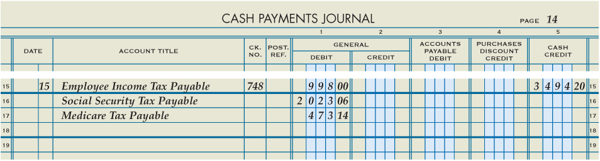
Journalizing Payment of Liability for Employee Income Tax, Social Security Tax, and Medicare Tax
Lesson 13-4
LO5
1
Date
2
Accounts Debited
3
Check Number
4
Debit Amounts
5
Check Amount

Slide 35
Paying the Liability for Federal Unemployment Tax
Lesson 13-4
LO5
FUTA taxes are paid by the end of the month following each quarter if the liability amount is more than $500.00.
However, all unemployment tax liabilities outstanding at the end of a calendar year must be paid.
FUTA tax is paid to the federal government using electronic funds transfer or the Electronic Federal Tax Payment System.
The deposit for FUTA tax is similar to the deposit required for income tax, social security tax, and Medicare tax.

Slide 36
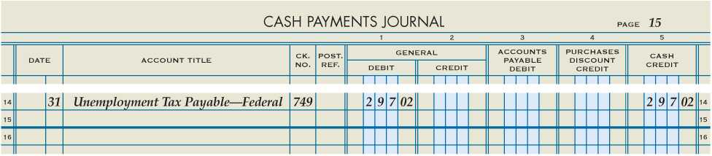
Journalizing Payment of Liability for Federal Unemployment Tax
Lesson 13-4
LO5
January 31. Paid cash for federal unemployment (FUTA) tax liability for quarter ended December 31, $297.02. Check No. 749.
Unemployment Tax Payable—Federal
Nov. 30 Bal 290.84
Dec. 15 3.89
Dec. 31 2.29
Jan. 31 Bal 297.02
Dec. 31 Bal 297.02
Cash
1
Date
2
Account Debited
3
Check Number
Jan. 31 297.02
4
Debit Amount
5
Check Amount

Slide 37
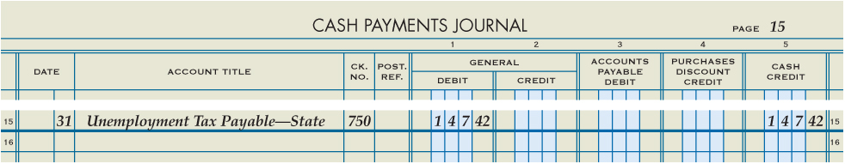
Journalizing Payment of Liability for State Unemployment Tax
Lesson 13-4
LO5
January 31. Paid cash for state unemployment (SUTA) tax liability for quarter ended December 31, $147.42. Check No. 750.
Unemployment Tax Payable—State
Nov. 30 Bal 105.74
Dec. 15 26.24
Dec. 31 15.44
Jan. 31 Bal 147.42
Dec. 31 Bal 147.42
Cash
1
Date
2
Account Debited
3
Check Number
Jan. 31 147.42
4
Debit Amount
5
Check Amount

Slide 38
Lesson 13-4 Audit Your Understanding
Lesson 13-4
1. For a monthly schedule depositor, when are payroll taxes paid to the federal government?
ANSWER
By the 15th day of the following month

Slide 39
Lesson 13-4 Audit Your Understanding
Lesson 13-4
2. By what method are businesses encouraged to deposit federal payroll taxes?
ANSWER
Using the Electronic Federal Tax Payment System

Slide 40
Work Together 13-4 On You Own 13-4
Work Together
13-4 (Excel)
Modeled
Page 397
On Your Own
13-4 (Excel)
Complete
Page 397

Slide 41
Application Problems
13-1 Application Problem
Excel
13-2 Application Problem
Excel
13-3 Application Problem
Print Form 941 Worksheet

Slide 42
Application Problems
13-4 Application Problem
Excel
13 Mastery Problem
Peachtree

Slide 43
Unit 13 Assessment
Unit 13 Review (ExamView)
90 % or Greater
5 Point Bonus on Unit 1 Concept Quiz (20% Bonus)
Unit 13 Part 1 Quiz (ExamView)
Concepts – 25 Questions (25 Points)
Unit 13 Part 2 Quiz (Excel)
Skills (30 Points)

